Slide 1

APEX INSTITUTE OF TECHNOLOGY
DEPARTMENT: CSE
Bachelor of Engineering (Computer Science & Engineering)
Machine Learning
DISCOVER . LEARN . EMPOWER

Slide 2
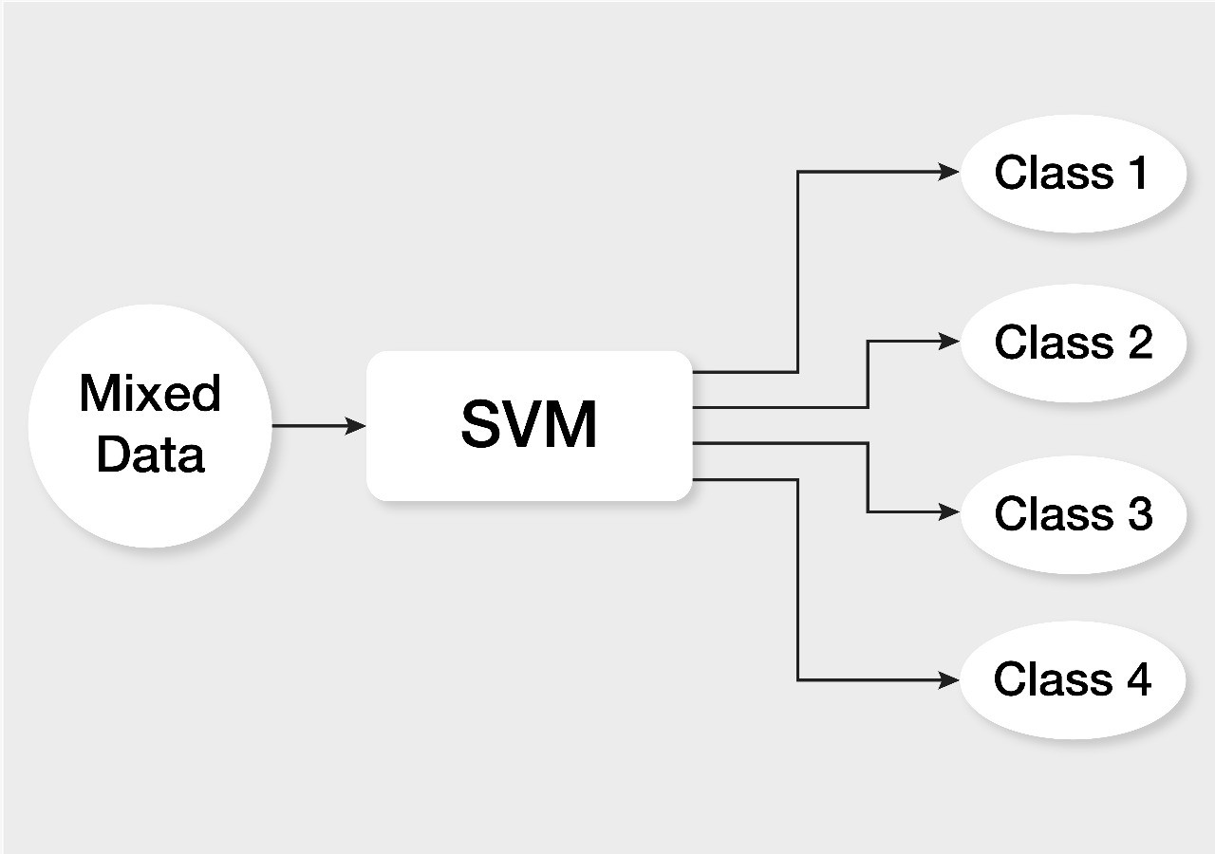
Course Objectives
CO1: To introduce students about the Margin Intuition.
CO2: To develop skills for Large Margin Intuition
CO3: To gain experience of doing independent study and research.

Slide 3
Course Outcomes
After this course student will be able to:
Have a good understanding of the Large Margin Intuition.
Appreciate the underlying mathematical relationships within and across Large Margin Intuition.
Design and implement various SVM for real-world applications.

Slide 4
Types of SVM
Linear SVM: Linear SVM is used for linearly separable data, which means if a dataset can be classified into two classes by using a single straight line, then such data is termed as linearly separable data, and classifier is used called as Linear SVM classifier.
Non-linear SVM: Non-Linear SVM is used for non-linearly separated data, which means if a dataset cannot be classified by using a straight line, then such data is termed as non-linear data and classifier used is called as Non-linear SVM classifier.

Slide 5
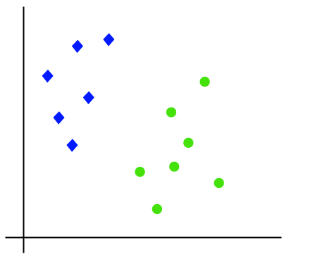
Linear SVM
Suppose we have a dataset that has two tags (green and blue), and the dataset has two features x1 and x2. We want a classifier that can classify the pair(x1, x2) of coordinates in either green or blue..

Slide 6
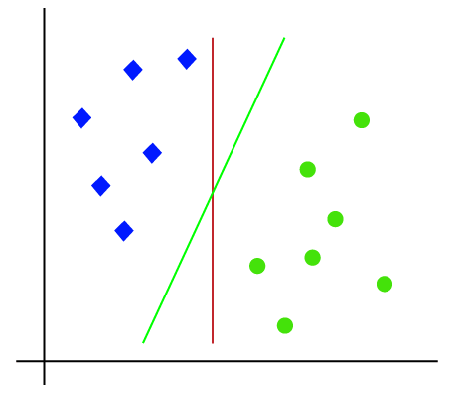
Linear SVM
So as it is 2-d space so by just using a straight line, we can easily separate these two classes. But there can be multiple lines that can separate these classes. Consider the below image:

Slide 7
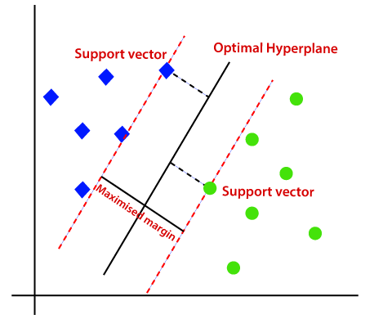
Linear SVM: https://www.youtube.com/watch?v=Js3GLb1xPhc
Hence, the SVM algorithm helps to find the best line or decision boundary; this best boundary or region is called as a hyperplane. SVM algorithm finds the closest point of the lines from both the classes. These points are called support vectors. The distance between the vectors and the hyperplane is called as margin. And the goal of SVM is to maximize this margin. The hyperplane with maximum margin is called the optimal hyperplane.

Slide 8
Linear SVM:Example

Slide 9
Linear SVM:Example

Slide 10


Linear SVM:Example

Slide 11


Linear SVM:Example

Slide 12




Linear SVM:Example

Slide 13
Tennis example
Temperature
Humidity
= play tennis
= do not play tennis

Slide 14
Linear Support Vector Machines
Data: <x_{i},y_{i}>, i=1,..,l
x_{i} ∈ R^{d}
y_{i} ∈ {-1,+1}
x2
=+1
=-1
x1

Slide 15
Linear SVM 2
Data: <x_{i},y_{i}>, i=1,..,l
x_{i} ∈ R^{d}
y_{i} ∈ {-1,+1}
All hyperplanes in R^{d} are parameterize by a vector (w) and a constant b.
Can be expressed as w•x+b=0 (remember the equation for a hyperplane
from algebra!) Our aim is to find such a hyperplane f(x)=sign(w•x+b), that
correctly classify our data.
f(x)
=-1
=+1

Slide 16
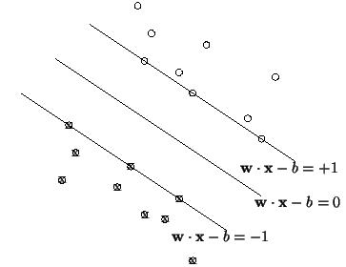
Definitions
Define the hyperplane H such that:
x_{i}•w+b ≥ +1 when y_{i} =+1
x_{i}•w+b ≤ -1 when y_{i} =-1
H1 and H2 are the planes:
H1: x_{i}•w+b = +1
H2: x_{i}•w+b = -1
The points on the planes H1 and H2 are the Support Vectors
H1
H2
H
d⁺
d⁻
d+ = the shortest distance to the closest positive point
d- = the shortest distance to the closest negative point
The margin of a separating hyperplane is d⁺ + d⁻.

Slide 17
Large Margin Intuition
In logistic regression, we take the output of the linear function and squash the value within the range of [0,1] using the sigmoid function. If the squashed value is greater than a threshold value(0.5) we assign it a label 1, else we assign it a label 0. In SVM, we take the output of the linear function and if that output is greater than 1, we identify it with one class and if the output is -1, we identify is with another class. Since the threshold values are changed to 1 and -1 in SVM, we obtain this reinforcement range of values([-1,1]) which acts as margin.

Slide 18
Support Vector Machine: Maximizing the margin
We want a classifier with as big margin as possible. W is weight vector
Recall the distance from a point(x₀,y₀) to a line:
Ax+By+c = 0 is|A x₀ +B y₀ +c|/sqrt(A²+B²)
H1
H
The distance between H and H1 is:
|w•x+b|/||w||=1/||w||
H2
d+
The distance between H1 and H2 is: 2/||w||
d-
https://www.youtube.com/watch?v=yCAlHPDgWtM
In order to maximize the margin, we need to minimize ||w||. With the
condition that there are no datapoints between H1 and H2:
x_{i}•w+b ≥ +1 when y_{i} =+1
x_{i}•w+b ≤ -1 when y_{i} =-1 Can be combined into yi(x_{i}•w) ≥ 1

Slide 19

Support Vector Machine: Maximizing the margin
D=(x2-x1).w/ ||w||= x2.w-x1.w/ ||w||= (1-b)-(-b-1)/||w||
D=2/||w||
argmax
H1
H
H2
d+
The distance between H1 and H2 is: 2/||w||
d-
https://www.youtube.com/watch?v=yCAlHPDgWtM
In order to maximize the margin, we need to minimize ||w||. With the
condition that there are no datapoints between H1 and H2:
x_{i}•w+b ≥ +1 when y_{i} =+1
x_{i}•w+b ≤ -1 when y_{i} =-1 Can be combined into yi(x_{i}•w) ≥ 1

Slide 20
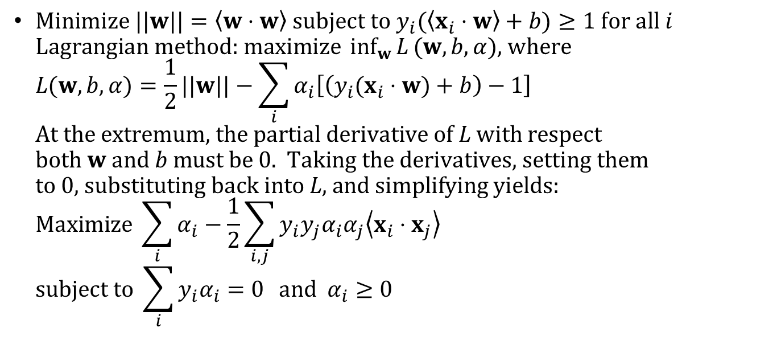
Constrained Optimization Problem
$\text{Minimize} ||w||=\left\langle w⋅w\right\rangle \text{subject} \text{to} y_{i}(\left\langle x_{i}⋅w\right\rangle +b)≥1 \text{for} \text{all} i$ $\text{Lagrangian} \text{method}\text{: }\text{maximize} \inf_{w}{L}(w,b,α)\text{, }\text{where}$ $L(w,b,α)=\frac{1}{2}||w||−\sum_{i}{α_{i}\left[\left(y_{i}(x_{i}⋅w)+b\right)−1\right]}$ $\text{At} \text{the} \text{extremum}\text{, }\text{the} \text{partial} \text{derivative} \text{of} L \text{with} \text{respect}$ $\text{both} w \text{and} b \text{must} \text{be}\text{ 0. }\text{Taking} \text{the} \text{derivatives}\text{, }\text{setting} \text{them}$ $\text{to}\text{ 0, }\text{substituting} \text{back} \text{into} L\text{, }\text{and} \text{simplifying} \text{yields}\text{:}$ $\text{Maximize} \sum_{i}{α_{i}−\frac{1}{2}\sum_{i,j}{y_{i}y_{j}α_{i}α_{j}\left\langle x_{i}⋅x_{j}\right\rangle }}$ $\text{subject} \text{to} \sum_{i}{y_{i}α_{i}=0} \text{and} α_{i}≥0$

Slide 21
Summary
If the squashed value is greater than a threshold value(0.5) we assign it a label 1, else we assign it a label 0.
In SVM, we take the output of the linear function and if that output is greater than 1, we identify it with one class and if the output is -1, we identify is with another class.

Slide 22

References
Mitchell T.M., Machine Learning, McGraw Hill (1997).
Chris Albon - Machine Learning with Python Cookbook_ Practical Solutions from Preprocessing to Deep Learning (2018, O’Reilly Media)
Sebastian Raschka, Vahid Mirjalili - Python Machine Learning_ Machine Learning and Deep Learning with Python, scikit-learn, and TensorFlow 2 (2019, Packt Publishing - ebooks Account)

